Slide 1
COMPANY OVERVIEW
NOVEMBER 2023

Slide 2
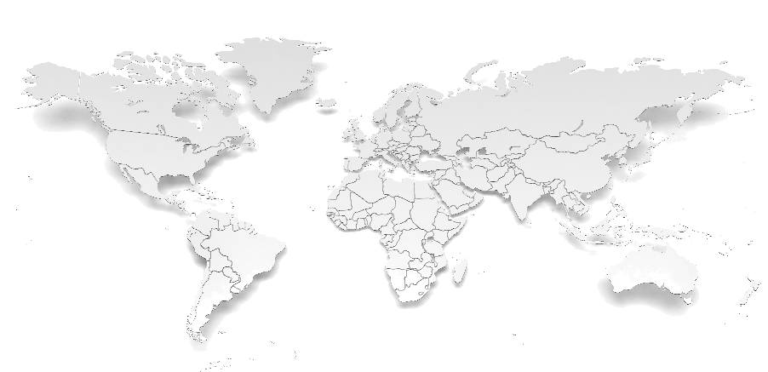
Meet
We enable systems and machines to sense, detect and respond to their environments at heightened levels.
Sensience’s advanced sensing technology, coupled with its exceptional sealing and limiting components, seamlessly integrates with the world’s leading brands and products, spanning from household appliances to electric vehicles.
COMPANY PROFILE
BUSINESS BREAKDOWN:
HEADQUARTERS
FOUNDED
Region
US
China
Europe Americas Rest of Asia
Industry
HVAC
Appliances Water Heater Industrial | A&D
Transportation
Columbus, OH
¹⁹⁴²
EMPLOYEES
ANNUAL PRODUCTION
Nearly
3,500
700⁺ Million
Units Manufactured
Multi-site, Multi-region Production for
Risk Mitigation
Leading Product Application Experts
Broadest Range of Product Options
Rapid Custom Prototypes
2
Copyright @2023 Sensience. All rights reserved. Confidential.

Slide 3
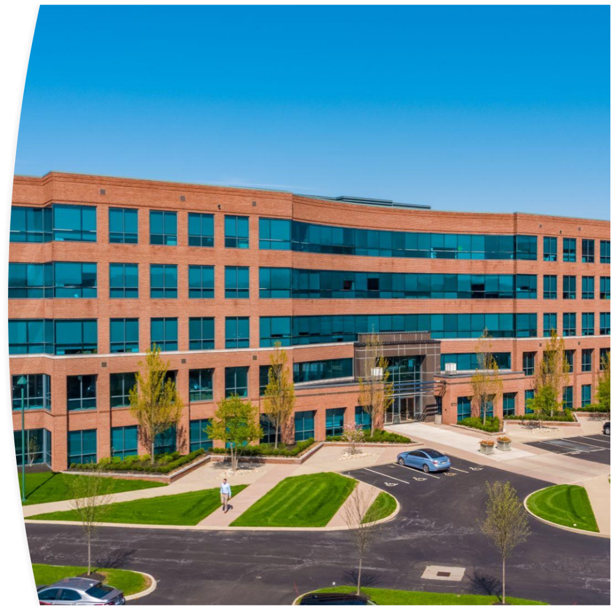
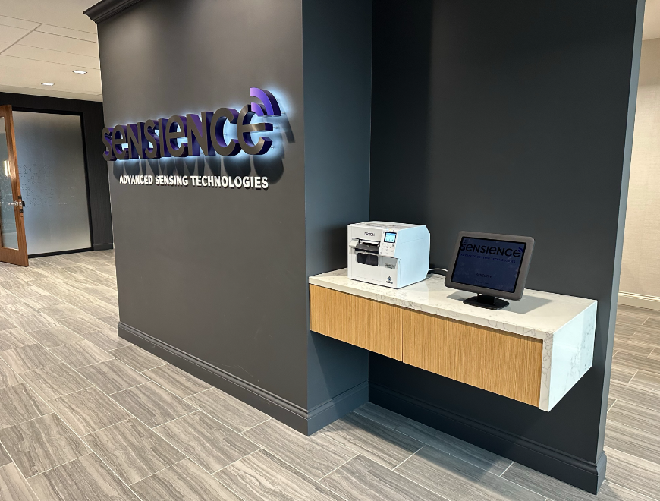
New Corporate HQ
570 Polaris Parkway, Suite 500, Westerville, OH 43082

Slide 4
Sensience Company Timeline
BUILDING FOUNDATION
PORTFOLIO EXPANSION
TRANSFORMATIONAL GROWTH
Both companies acquired by Emerson to diversify industrial portfolio
Transformed to a stand-alone company via acquisition by One Rock Capital Partners
1970’s
2022
1940’s
1980-2000’s
2023 & BEYOND
Fusite founded in 1942 introducing one piece hermetically sealed feedthroughs.
Therm-O-Disc founded in 1947 with the invention of the bi-metal disc.
Continued expansion via acquisition into additional sensor technologies and new market verticals
Focus on Innovation-led growth around sustainability, decarbonization & connected technologies
Copyright @2023 Sensience. All rights reserved. Confidential.

Slide 5
OUR PORTFOLIO OF BRANDS
OUR MISSION
To enable a cleaner, safer, more connected world by providing industry leading sensing technologies ensuring reliable and efficient operation of products that improve the way we all live, work and play
PROVEN
For over 75 years we’ve been a partner to the worlds leading OEM’s.
INNOVATIVE
We foster a culture of innovation and new product development
We are committed the well-being of our employees and uphold the highest standards of safety and operational excellence
SAFE
AGILE
We develop configurable platforms that can be right-fit to your specific needs.
SUSTAINABLE
We are dedicated to making the world a cleaner, more efficient, safe and connected place.
Copyright @2023 Sensience. All rights reserved. Confidential.

Slide 6
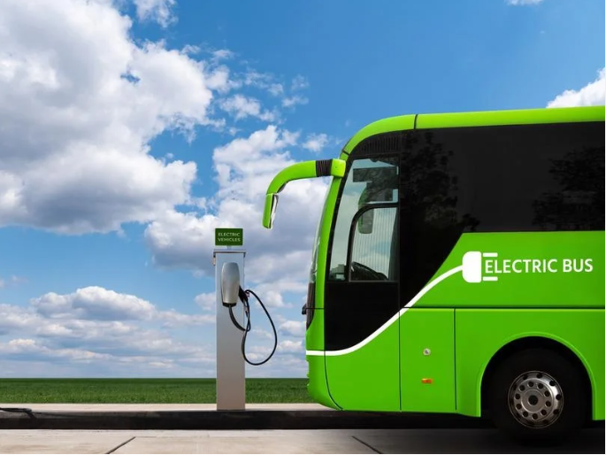
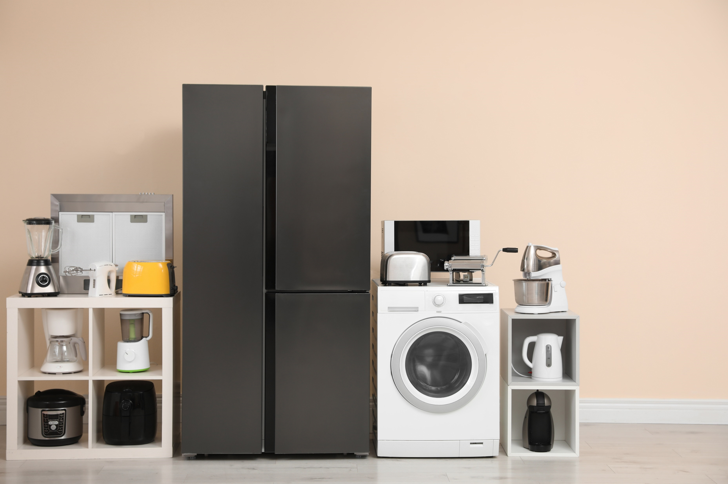
Across industries, Sensience helps the people engineering, designing and building a connected future create heightened awareness by connection systems to environments, data and new thinking.
INDUSTRIES SERVED
HVACR
ENERGY
TRANSPORTATION
APPLIANCE
AEROSPACE & DEFENSE
Copyright @2023 Sensience. All rights reserved. Confidential.

Slide 7
VALUES
CUSTOMERS
Customers define our success.
Ensuring our customer's success creates a space where we both can grow and succeed.
INNOVATION
Our curiosity drives innovation.
We think outside of the box to provide solutions to our customers toughest challenges.
ACCOUNTABILITY
We are accountable for results.
We do what we say, and we say what we do. We are accountable for driving business results with the utmost ethical integrity.
INCLUSION
Diversity, equity and inclusion are core to our team’s success.
We create an environment where all employees can reach their full potential by bringing their full selves to work.
PEOPLE
We invest in our people.
We invest time and resources to develop our teams and provide fulfilling career opportunities.

Slide 8
Optimized Global Footprint
❶ ❷
Wigan, UK
Netherlands
❸
Cluj, RO
❹
Muskegon, MI
❶ ❷
Hampstead, NH
❶ ❷ ❸
HQ-Columbus, OH
Gotemba, JP
❸
❶
Juarez, MX
❷ ❹
Tongling, CHN
❶ ❷ ❸
❷
Chihuahua, MX
❶
Delicias, MX
Hong Kong, CHN
❸
Zhuhai, CHN
❶ ❷ ❸
Prachinburi, TH
❶ ❷ ❸
LEGEND
Every Major Region of The World
Global Engineering & Sales Support
Regional Manufacturing
❶ Production
❷ Engineering
❸ Distribution
Admin
8
Copyright @2023 Sensience. All rights reserved. Confidential.
Notes:
8

Slide 9
SENSIENCE ALIGNED WITH GLOBAL
MACRO TRENDS
SUSTAINABILITY
DECARBONIZATION
Low GWP Refrigerants
Energy Efficiency Regulations
ELECTRIFICATION
EV Market Expansion
Heat Pump Technology
DIGITIZATION
Connected Technologies Directly Tied to Sensors
Copyright @2023 Sensience. All rights reserved. Confidential.

Slide 10
Sustainability with Certainty
Sensience has been awarded the EcoVadis Silver Medal Rating, placing it in the top 25% of all companies assessed. The results of the assessment show that our top performing sustainability themes are Environment, Ethics, Labor & Human Rights.
Sensience is committed to a 50% reduction in Emissions normalized to sales and committed to setting Science Based Targets.
Sensience upholds transparency regarding its environmental performance through its annual disclosure to CDP via the Private Markets Questionnaire.
Sensience's environmental stewardship is underscored by its achievement of ISO 14001 Environmental Management System Certification at four out of its five major manufacturing sites.

